Slide 1
Capitalisation in Interreg and ENI CBC
“CBC along the EU’s external borders:
lessons learnt and ways forward”
30 November 2017 I Tallin, Estonia
Ivano Magazzù - Interact Programme

Slide 2

Capitalisation is …

Slide 3
Capitalisation, do we all have the same understanding?
Capitalisation is about gathering, organising and building upon existing programme and projects results, within specific fields.
Capitalisation could concern data about the implementation of programmes, projects, impacts and methods used in order to make this knowledge generated by Interreg (capital) more accessible and usable for other programmes, projects or stakeholder groups.
Capitalisation (of results) looks into specific results in thematic fields in order to obtain additional improved results, to boost performance, delivery and to multiply the effects of achievements delivered.

Slide 4

How do we implement capitalisation?
Gathering results → analysis (projects), coordination
Promotion of results → promotional and capitalisation events/targeted campaigns, networking events, simplicity of language
Re-use of results → validation/follow-up, effects?
Influence policies → link with public decisions, modifing legislations

Slide 5
What is capitalisation in Interreg and ENI CBC?

Slide 6

Challenges for capitalisation:
Indeed, capitalisation activities face several limits and challenges:
they are often restricted to the promotion of projects, and sometimes without tangible results on its added value,
they go rarely beyond the dissemination of results,
there are still stakeholders involved in ETC and ENI CBC programmes who are not convinced of the added-value of such an exercise - like capitalisation - or who think that transfer is not suitable face-to-face with programme’s territorial approach.

Slide 7

Why capitalisation is needed for 2014-20:
Now, more than ever, it’s crucial to develop capitalisation activities in order to:
promote programmes’ achievements and demonstrate the added-value of cooperation, thus promoting new answers to territorial challenges
use programmers’ results in order to improve the quality of implementation as well as to improve mainstreaming into regional programmes and policies
make programmes more visible with tangible results and to provide solid inputs in the framework of post-2020 discussions.
… a first answer comes…

Slide 8
Interact Capitalisation Plan
Objectives
To define the main actions and work
Identification, analysis and promotion of capitalisation approaches;
Set-up and implementation of thematic networks;
Promotion of Interreg results.
Clear identification of themes
Specific survey to Programmes, according to thematic choises

Slide 9
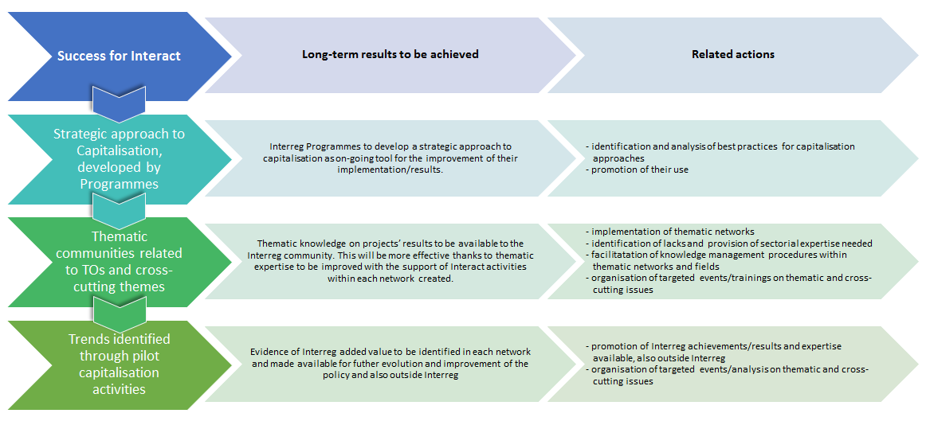
Capitalisation of Interreg results: how?
Interact has defined a series of long-term strategies, results :
1
2
3

Slide 10
Paper on capitalisation practices repository – 1/2

Slide 11
Paper on capitalisation practices repository - 2/2
Level of intervention | Nature of capitalisation activities regarding the offer side | Nature of “enhanced value” activities regarding the demand side | Operational tools and methodologies (database, events, participative methods, publications…) – n°1 & n° 2 | Degree of embedding capitalisation activities into programme life-cycle / programme management process | Degree of replicability of the capitalisation process (at least among programmes belonging to the same ETC strand)
* On project level * At territorial level * On programme level * On inter-programme level within Interreg * With other European programmes or initiatives on specific thematic fields | * calls for capitalisation projects * calls for thematic clusters /cross-cutting projects * thematic analysis (in-house or with external experts’ support) * identification and selection of good practice owners * exchanges among regional and national authorities in order to improve the transfer of practices at the political level * development of collaborative networks * dissemination of capitalised results * support of local stakeholders in the transfer of good practices and improvement of local policies | * identification and motivation of potential re-users * creation of communities with givers and takers (targeted stakeholders) * involvement of stakeholders wishing to import knowledge * not significant | * publications (brochure, factsheets on good practice, etc.) * events (thematic workshops, peer-review, policy learning event, matchmaking event, etc.) * database of good practice validated by experts / database of practitioners * online collaborative tool * expert helpdesk * participative method of capitalisation involving various types of stakeholders * mainstreaming of good practice * use of KEEP database * n.a. (not applicable) | 3 = strong 2 = medium 1 = weak | 3 = high 2 = intermediate 1 = low

Slide 12
Nature of capitalisation activities

Slide 13
Operational tools and methodologies

Slide 14
Support to Capitalisation 2017 – Latest updates
Support to programmes:
Publication on capitalisation practices
Publication on communication of capitalisation results
Soon available – www.interact-eu.net
Cap&Com 2 WS – Bilbao, 28-29 November 2017: more focus on project examples, interesting stories (from the point of view of EC)
Meeting of Knowledge of the Seas Network – Oporto, 21-22 November 2017
Meeting of Sustainable Transport Network – Vienna, 29-30 November 2017
Meeting of Climate Change Network – Venice, 30 Nov – 1 December 2017

Slide 15
Interact Capitalisation Networks
The capitalisation networks:
constitute a resource for gaining new contacts and knowledge, providing opportunities and inspiration;
are a support framework to refer to for advice, support, coaching, mentoring for its members and even beyond.
establish synergies with other initiatives and contexts which are not related to the Regional Policy and whose focus is in line with the issues addressed through the capitalisation networks.
serve both the purpose of learning/receiving as well as of promoting/sharing knowledge, information and achievements of Cooperation Programmes.
The main users of the networks are the Interreg, Interreg IPA CBC and ENI CBC Programmes.

Slide 16
Interact Capitalisation Networks: features
A way to capitalise Interreg results...

Slide 17
Thematic support to Programmes
Interreg Europe | Interact
Research, technological development and innovation (TO 1) | Migration
Competitiveness of SME’s (TO 3) | Sustainable transport (TO 7)
Shift towards a low-carbon economy (TO 4) | Maritime issues/Knowledge of the Seas
Preserving and protecting the environment and promoting resource efficiency (TO 6) | Climate change and risk management (TO 5)
 | Inclusive growth (TO 8-9-10)
 | Better governance (TO 11)
Invitation letter to join ICNs to all ENI CBC MAs – Oct. 2017

Slide 18
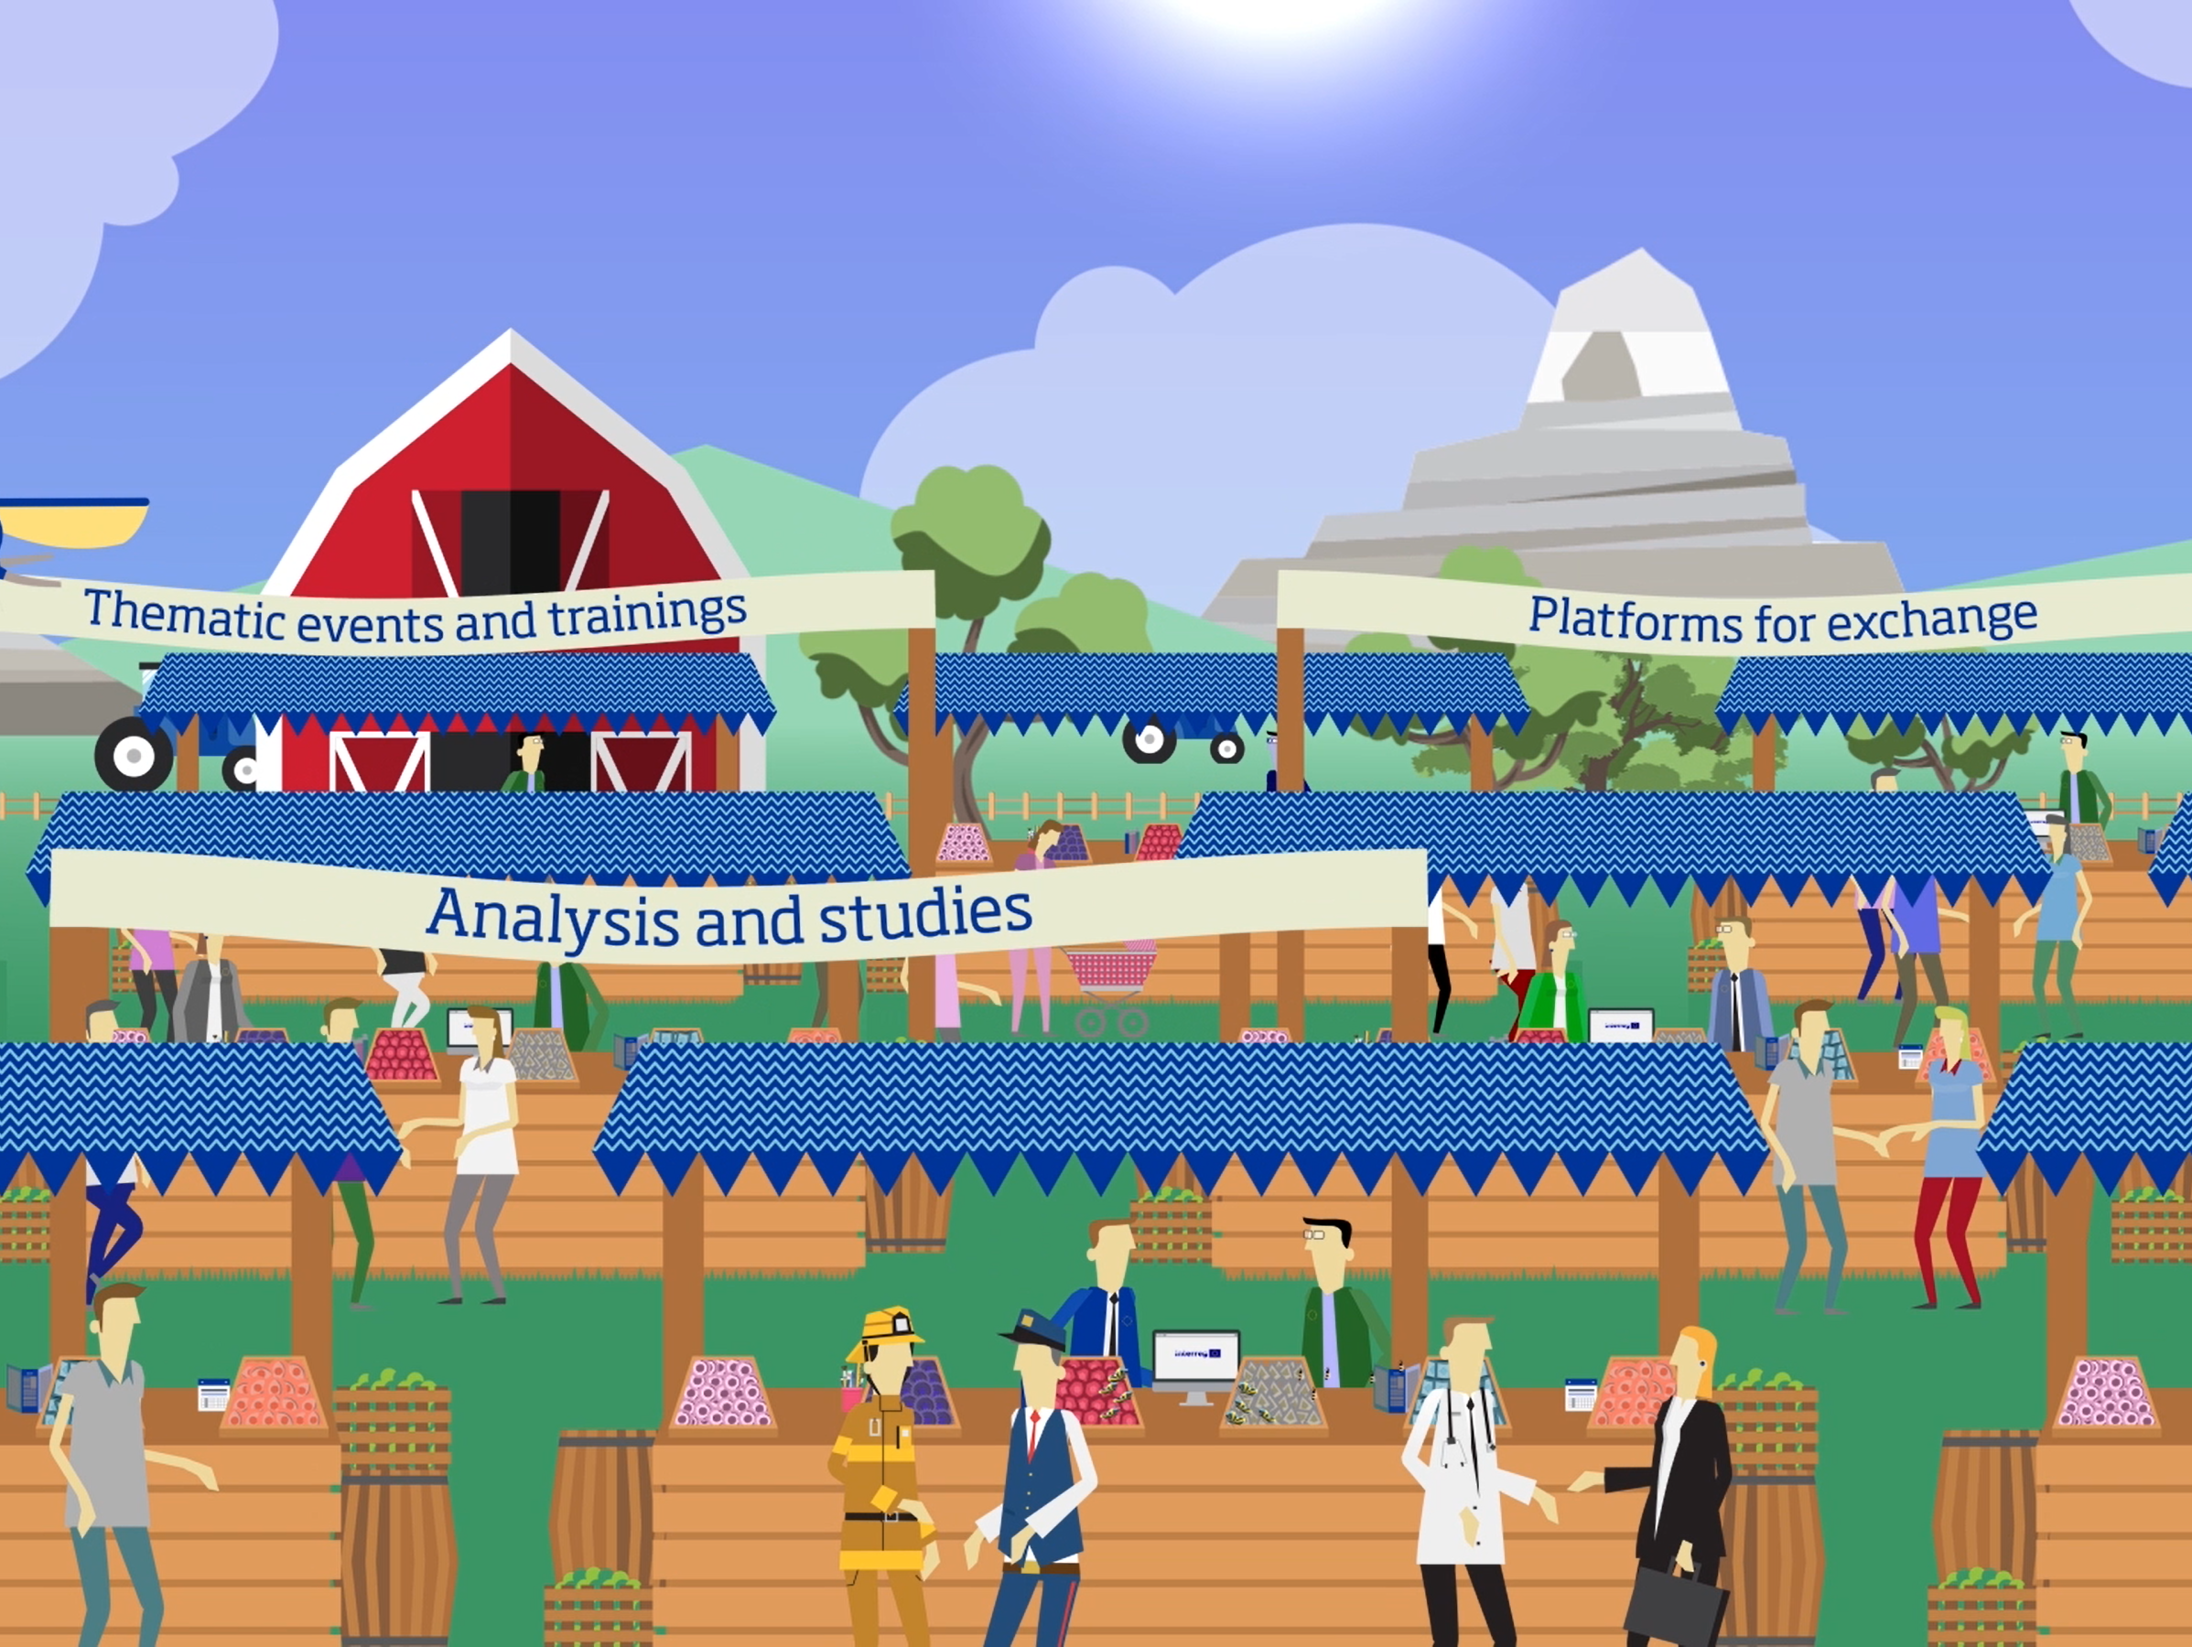

Slide 19
Support to Capitalisation 2018
Capitalisation as management practice: Workshops, trainings, publications and materials | Thematic network: Meetings, on-line platforms, pubications
Event on Capitalisation practices | Interreg response to migration network
Capitalisation WG to prepare a Cap toolkit (process and strategy/plan templates) | Sustainable transport
CapCom event – Communication of results | Knowledge of the seas network
Advisory on capitalisation and hotline | Climate change network
 | Inclusive growth network
 | Better governance network

Slide 20
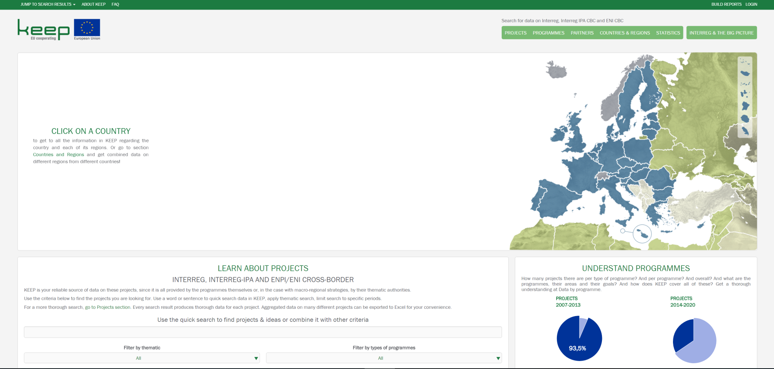
KEEP

Slide 21
Further opportunities for ENI Programmes
All services available and open also to ENI Programmes (events, meetings, tolos and publications),
Definition of common elements of a capitalisation process within the programme life-cycle
Cooperation with TESIM in the framework of the assistance to individual capitalisation processes,
Share of programmes’ results in the ICNs

Slide 22


Cooperation works
All materials available on:
www.interact-eu.net
Contact: Ivano Magazzu, ivano.magazzu@interact-eu

