Slide 1


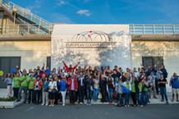





PARTNERSHIP cross-border cooperation
INTERREG - IPA CBC Programme Bulgaria–Turkey
CCI 2014TC16I5CB005

Slide 2


Partnership and Cross-border Cooperation
by definition…
partnership
[ˈpɑːtnəʃɪp], noun*
the state or condition of being a partner,
formal or unformal union of persons or organizations closely involved in some way
Synonyms:
cooperation, union, connection, friendship
* Cambridge Advanced Learner’s Dictionary,
Cambridge University Press ©

Slide 3
Partnership and Cross-border Cooperation
within the Programme…
partnership
formal union of institutions created in order to implement a project, according to officially established cooperation principles and procedures for collaboration in compliance with Programme requirements
Rules concerning partnership
The partnership should include at least 1 partner from each side of the border region acting in full spirit of cooperation
The partnership should be constituted upon an agreement formally signed by all partners. The Project Partnership Agreement stipulates the rights and duties of the parties and establishes the principle of the Lead Partner
The partnership is officially represented by the Lead Partner, appointed among all project partners and entitled with certain obligations before the Managing Authority for general coordination, management and implementation of the project
The partnership should not consist of more than 5 partners including the Lead Partner.
The partnership should comprise of partners meeting certain eligibility criteria

Slide 4

Partnership and Cross-border Cooperation
Number of project proposals
1
Only 1 project proposal may be submitted by an organization
as a Lead Partner
max
In case an organization/institution submits a proposal as a Lead Partner, it can be a partner in no more than 2 other projects
3
No more than 3 project proposals may be submitted by an organization
as a Partner
max
In case an organization/institution does not submit a project as a Lead Partner it can participate as a partner in no more than 3 projects
If these limitations to Partnership are not observed all project proposals submitted by the partners will be rejected

Slide 5
Eligibility of Applicants
Who can become a project partner?
Lead Partner and Partners should be cumulatively
Legally established organizations (legal persons) according to the national legislation of the state on whose territory they are located
Registered in the eligible cross-border region between Bulgaria and Turkey
Non-profit making organizations
Directly responsible for the preparation and management of the action, not acting as an intermediary
Partners are also considered ineligible to participate in the Call for proposals if fall into any of the categories listed in p. 2.5.1.1, 2) of the Guidelines for applicants such as bankruptcy, insolvency, breach of obligations related to taxes or social security
Exceptions to Eligibility rules
In case a subsidiary structure of local/regional/national authority is not and cannot act as a legal entity the legally established central organization, if such exists, shall be the project partner
In case according to legal acts the area of competence of national/regional public authorities extends to the eligible area of the Programme, or structures of central public authorities located in the eligible cross border region cannot be registered as legal entities the central authority shall be the project partner

Slide 6
Lead Partner Principle
What means ‘Lead partner’?
Lead Partner
Prior to submission of the project proposal a Lead partner is appointed among all project partners for each project.
The Lead partner is the official representative of the partnership and carries certain responsibilities towards the partners and the Programme. The key role of the Lead partner is formally established and agreed upon by all project partners in the Project Partnership Agreement
Lead Partner should be registered
within the eligible border region between Bulgaria and Turkey
+
at least 12 months before the deadline for submission of the project proposal
Lead Partner tasks include at least
signing the Subsidy contract and any further addenda with the MA
laying down arrangements with other partners that guarantee project implementation and financial management
collecting and checking the information from project partners and reporting
ensuring that expenditures have incurred in implementing project activities
transferring budget amounts to the partners according to verified costs

Slide 7
Project Partnership Agreement
What is Partnership agreement?
Project Partnership Agreement is a document that
specifies the requirements for the parties for correct project management
establishes the rights and responsibilities of all partners
settles rules for cooperation with bodies external for the project
guarantees sound financial management of project funds
arranges obligations for recovering granted subsidy in cases of unduly paid amounts
Project Partnership Agreement is
&
legal
binding
arrangement that should be signed by all partners with utmost awareness
Project Partnership Agreement template (Annex 2) is enclosed to the Guidelines for Applicants
Project Partnership Agreement template is indicating the minimum requirements for the content of the Project Partnership Agreement
Partners may decide to add additional provisions and extend in more details the agreement for their project

Slide 8
Cross-border Impact
What partnership aims?
cooperation
territorial cohesion
cross-border impact
Cross-border impact is ensured when
The project provides tangible results in the cross-border area in both countries
The project delivers benefits not only for the project partners but also for the cross-border target groups and the Programme area
Project activities are designed for facing specific needs and restraints of the border region
The project outputs gain additional added value for the cross-border area
The project implementation enhances cross-border cooperation
The project proposal contributes to strengthening collaboration capacity
The project encourages cross-border approach and influences overcoming regional divergences
Project objectives address territorial cohesion strategies at Programme/national/regional level

Slide 9
Cooperation Criteria
How is cross-border impact measured?
Cross-border impact is respecting at least 3 of the following criteria
common creation and design by incorporating in one project proposal the ideas, priorities and needs of stakeholders from both sides of the cross-border region
mandatory
clearly demonstrated
Joint development
connected, closely linked and coordinated by project partners from both sides of the border activities that ensure constant cross-border contact
Joint implementation
project management carried by one project team with members nominated by all project partners and responsible for actions on both sides of the border
one by choice
Joint staffing
common financial arrangement of project implementation - one project budget divided between partners according to activities, one bank account for the EU contribution
Joint financing
Establishing a partnership among organizations from the two countries brings a cross-border character to the project but is not enough only by itself to ensure the direct cross-border impact

Slide 10


Partnership Development
How to choose partners?
Developing your partnership you need to consider
What are Programme’s requirements for the Partnership?
Which partners are needed to achieve project objectives and results?
Eligibility of partners
Stick strictly to the Rules for Partnership, Eligibility of Partners and Eligibility of Applicants set in the Guidelines for the Call for proposals
Partnership size
Partnership size impacts the efficiency of project implementation. Larger partnerships require more coordination in reporting and financial management. Small partnerships may lack capacity. Consider critically each partner’s abilities
Partnership composition
Partners should have the necessary expertise and knowledge to contribute to the project. Similar expertise helps to ensure efficient implementation of activities in each partner country and address similar problems. Partners with different expertise can complement each other so that the skills of one partner match the needs of other partners

Slide 11


Partnership and Project Idea
Who is the right partner?
Mind the Rules of the Call for Proposals
Projects will be financed after competitive selection
High priority will be given to projects contributing to Programme output indicators, that have not been achieved
PA 1 Environment
Possible actions
Cooperation initiatives in the field of marine litter reduction
Supply of equipment for protecting/preserving/monitoring the ecosystems and for control of pollution
Coordinated actions aiming restoration of the natural processes in protected areas
Development of joint plans for preservation of protected areas based on innovative concepts
Joint initiatives for effective management of protected areas
Specific Objective 1.2
OI 1.2.5 Number of joint management plans/coordinated specific conservation activities for protected areas
‘Unreached’ Indicators
OI 1.2.4 Number of joint initiatives addressing preservation of marine and coastal environment (incl. litter reduction)

Slide 12



Partnership and Project Idea
Who is the right partner?
PA 2 Sustainable Tourism
Specific Objective 2.1
Possible actions
OI 2.1.1 Total length of reconstructed or upgraded access roads to natural, cultural and historic tourism sites
Investments for accessibility to touristic sites - access roads, cycling routes, walking paths
Upgrade of public utilities on tourism sites - electricity, water-supply, sewerage
Investments for restoration and conservation of touristic sites
OI 2.1.2 Total length of newly built, reconstructed or upgraded cycling routes/walking paths
‘Unreached’ Indicators
OI.2.1.3 Number of newly built/ reconstructed facilities in/leading to touristic sites
OI.2.1.4 Number of reconstructed/ restored cultural and historical touristic sites
Specific Objective 2.2
Possible actions
OI 2.2.5 Number of people involved in training and capacity building activities in the field of sustainable tourism
Training and consultancy support for touristic organizations to improve their products, services, performance and staff skills
Joint public activities for promotion of common tourist destinations in the border region
Specific Objective 2.3
OI.2.3.2 Number of public awareness initiatives promoting sustainable use of natural, historical and cultural heritage and resources

Slide 13
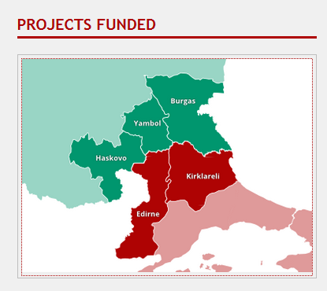
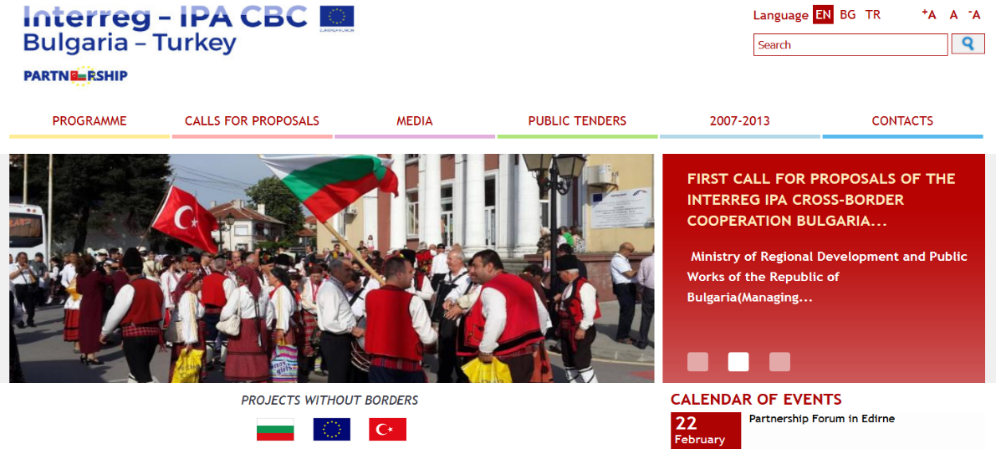
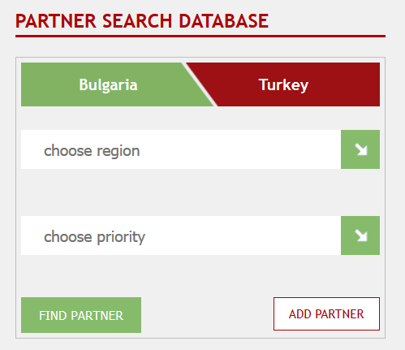
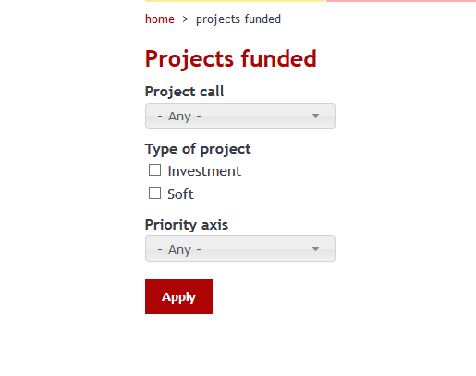
Partner Search
How to find a partner?
Support to find project partners
Partner Search Database
http://www.ipacbc-bgtr.eu/
Register your organization or
check for partners
Get reference for already created partnerships

Slide 14

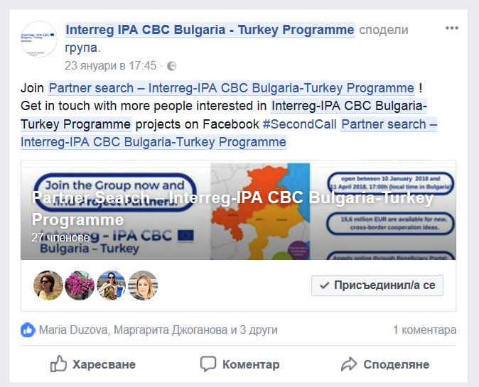
Partner Search
How to find a partner?
www.facebook.com/BulgariaTurkey/
Follow us on-line
www.facebook.com/
groups/PartnerSearchInterregIPABGTR/
Join the Partner Search Group

Slide 15

Partnership Assessment
How is partnership estimated?
Your Partnership will be evaluated
1
at the stage of
Administrative and Eligibility check
Your project proposal will be checked for compliance with certain administrative and eligibility criteria deriving from the partnership you have created
The project proposal continues to next stage of assessment only if all criteria are met
Criteria for administrative and eligibility compliance related to partnership
Does the partnership include at least one partner from each side of the cross-border region is involved?
Is the requirement for the maximum number of participations of an organization as a Lead partner or project partner satisfied?
Is the Lead partner registered at least 12 months before the deadline for submission of project proposals?
Do all project partners incl. the Lead partner meet the eligibility criteria defined in Section 2.5.1 of the Guidelines for Applicants?
Are at least 3 of the cooperation criteria clearly fulfilled by the project proposal? Is the mandatory cooperation in joint development and in joint implementation included?

Slide 16

Partnership Assessment
How is partnership estimated?
2
at the stage of
Technical and Quality Assessment
External assessors will rate the capacity of your partnership. The maximum points awarded can be 15 out of 100 i.e. weight of 15% in the overall score
Partnership capacity check includes
Competence of project partners to implement the project activities
Composition of the partnership in relevance to the proposed project
Experience of project partners in project management of public funded projects, especially in the field addressed by the project
Project partners resources – financial status, staff, equipment
Project content, budget and consistency with the Programme will be estimated compared to partnership’s capacity considering
Focus of activities on joint initiatives and finding common solutions
Coherence with Programme objectives and contribution to territorial cooperation
Level of involvement and participation of project partners in activities
Compliance between activities and partners competences and expertise
Breakdown of project budget between partners
Ability of project partners to ensure institutional and financial sustainability of project results

Slide 17





Partnership and project implementation
How to develop partners cooperation?
Implement
Project partners carry common tasks with the aim to deliver project outputs
Monitor
Project partners report to the Lead partner who informs programme bodies for project progress
Manage
Project partners inform the partnership for deviations and estimate the impact of modifications. Identify and assess risks, and apply risk management actions
Communicate
Project partners regularly exchange status information and plan next activities
Project implementation depends on the level of coordination between partners and the quality of partnering relationship

Slide 18






Partnership and project implementation
Challenges the partnership may face?
Working with different
cultures and languages
share experiences and establish a way of working together
Working remotely
modern technologies help but do not replace face-to-face contacts in building trust
Meeting requirements
develop knowledge for the Programme requirements - reporting, control, audit
Need of own funds
financial resources to pre-finance project costs until reimbursement of expenditures
Building a partnership from the start requires more time and work but completely new partnerships can develop and successfully deliver projects

Slide 19


Partnership and project implementation
Why is cooperation level so important?
Partnership modifications
Inactive partners or partners that fail to fulfil their obligations may threaten project implementation and the partnership be forced to exclude the partner
Project partner may decide to leave the partnership because he didn’t have clear idea of partner’s obligations at application
In any cases dropping out of a partner is a high impact risk for project implementation and leads to serious administrative implications
Is there still a viable cooperation partnership
Do any new organizations comply to programme requirements?
Is there a need the project to be reconsidered by programme authorities?
Irregularities
Partners are liable for irregularities in the declared by them expenditures. In case of suspicion of irregularity the reimbursement of project funds by the programme is terminated until final decision

Slide 20
Partnership and Sustainability
What is sustainability of project results?
Partnership continues after project end
Project partners have to ensure sustainability of project results for
2
5
for investment measures
for soft measures
years
years
Project partners responsibilities
Availability
web-site, services, equipment, new assets exist
Use
assets are used as intended, strategies & plans are applied
Maintenance
gained assets are in good condition
Publicity
Programme visibility rules are respected
Archive
project records are kept for audit purposes

Slide 21
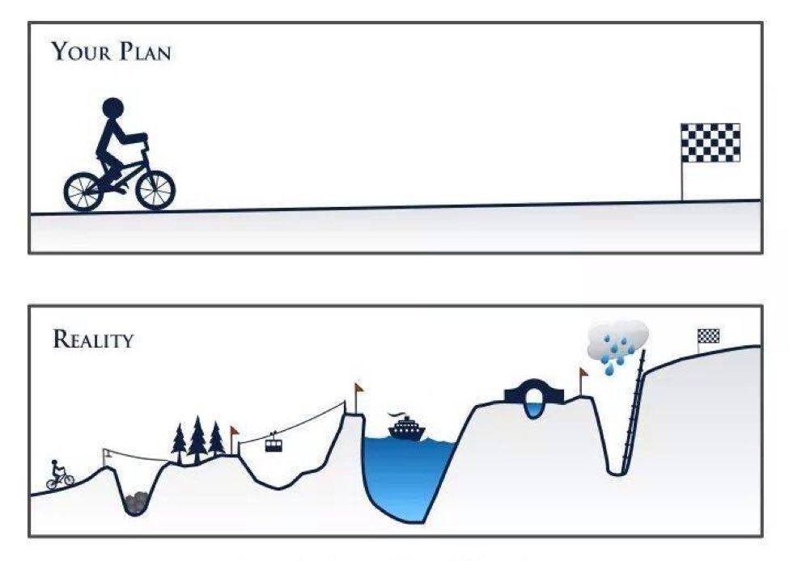


Partnership and cross-border impact
conclusions…
Partnership
may seem an easy undertaking …
but may become a great challenge!
It is important who will accompany you in project implementation
On the quality of your partnership depends the success of your project
The choice of a partner is more important than the project idea itself
Effective partnership will be your strategy to cope with problems during project implementation

Slide 22

INTERREG - IPA CBC Programme Bulgaria–Turkey
CCI 2014TC16I5CB005
Thank you for your attention
The Programme is co-financed by the European Union

